Slide 1




University Institute of Engineering
Department of Computer Science & Engineering
COMPUTER ORGANIZATION & ARCHITECTURE
(23CST-204/23ITT-204)
ER. SHIKHA ATWAL
E11186
ASSISTANT PROFESSOR
BE-CSE

Slide 2
Overview of memory and I/O addressing
As a CPU needs to communicate with the various memory and input/output devices (I/O), we know that data between the processor and these devices flows with the help of the system bus. There are three ways in which a system bus can be allotted to them:
separate sets of address, control, and data buses to I/O and memory.
Have a common bus (data and address) for I/O and memory but separate control lines.
Have a common bus (data, address, and control) for I/O and memory.
In the first case, it is simple because both have different sets of address space and instructions but require more buses.

Slide 3
Isolated I/O
Then we have isolated I/O, in which we have a common bus (data and address) for I/O and memory but separate read and write control lines for I/O. So, when the CPU decodes an instruction, if the data is for I/O, it places the address on the address line and set I/O read or write control line, due to which data transfer occurs between the CPU and I/O. Because the address space of memory and I/O is isolated, as is the name, the address for I/O here is called ports. Here we have different read-write instructions for both I/O and memory.

Slide 4
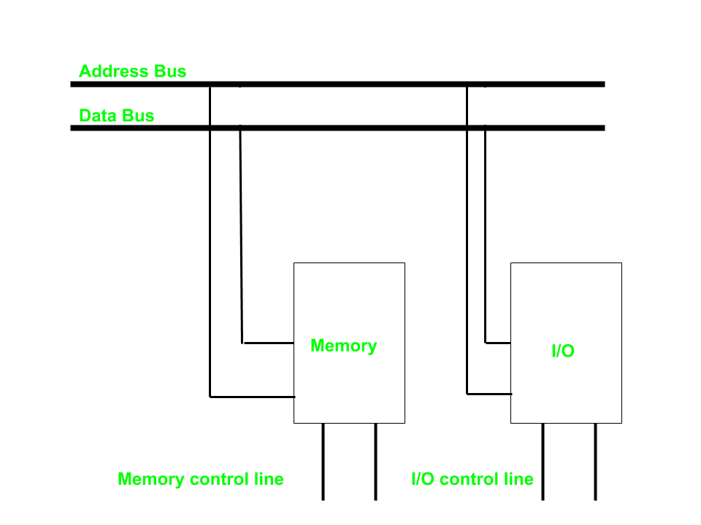

Slide 5
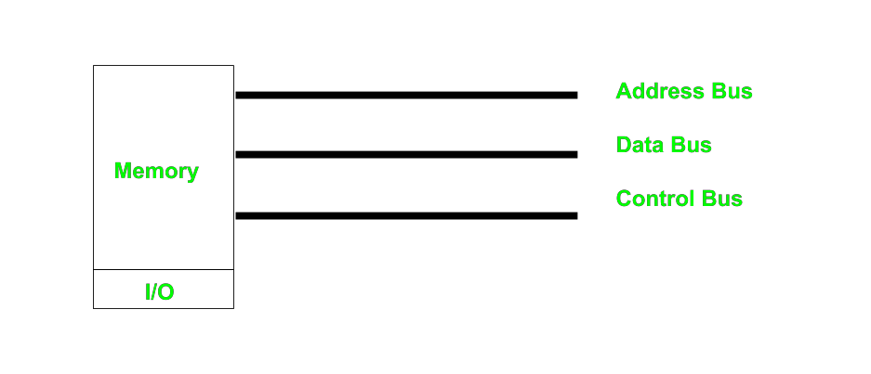
Memory-mapped I/O
Every bus has something in common in this case because the same set of instructions is used for memory and I/O. Hence, we manipulate I/O the same as memory, and both have the same address space, due to which the addressing capability of memory becomes less as some part is occupied by the I/O.

Slide 6
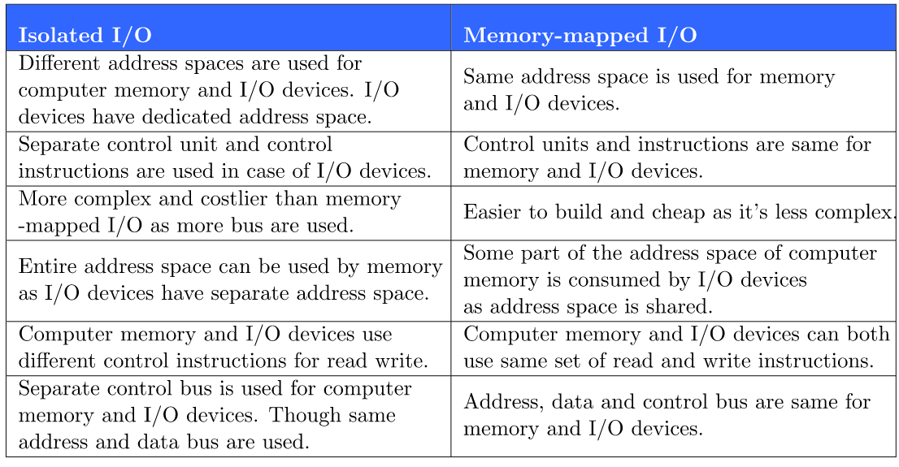
Differences between memory mapped I/O and isolated I/O

Slide 7
References
Reference Books:
J.P. Hayes, “Computer Architecture and Organization”, Third Edition.
Mano, M., “Computer System Architecture”, Third Edition, Prentice Hall.
Stallings, W., “Computer Organization and Architecture”, Eighth Edition, Pearson Education.
Text Books:
Carpinelli J.D,” Computer systems organization & Architecture”, Fourth Edition, Addison Wesley.
Patterson and Hennessy, “Computer Architecture” , Fifth Edition Morgaon Kauffman.

Slide 8
Reference Website:
Memory Maps and I/O Addressing | Basics of Programmable Logic Controllers (PLCs) | Automation Textbook
Memory and I/O Interfacing - javatpoint
Memory-Mapped vs. Isolated I/O | Baeldung on Computer Science

